Slide 1



Ethics in IT
Class IX
lab 1

Slide 2


Email Hijacking
Email hacking is the unauthorized access to, or manipulation of, an email account or email correspondence

Slide 3
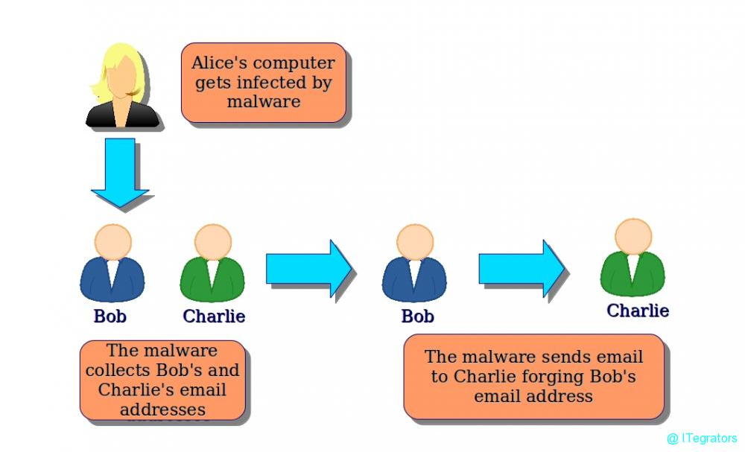
Email Spoofing
the spammer sends emails from a known domain, so the receiver thinks that he knows this person and opens the mail

Slide 4
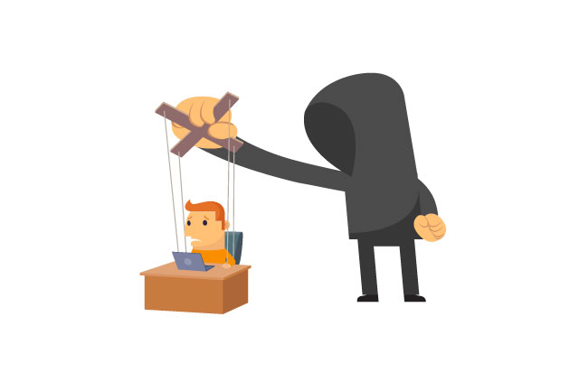
Social Engineering
Spammers send promotional mails to different users, offering huge discount and tricking them to fill their personal data

Slide 5
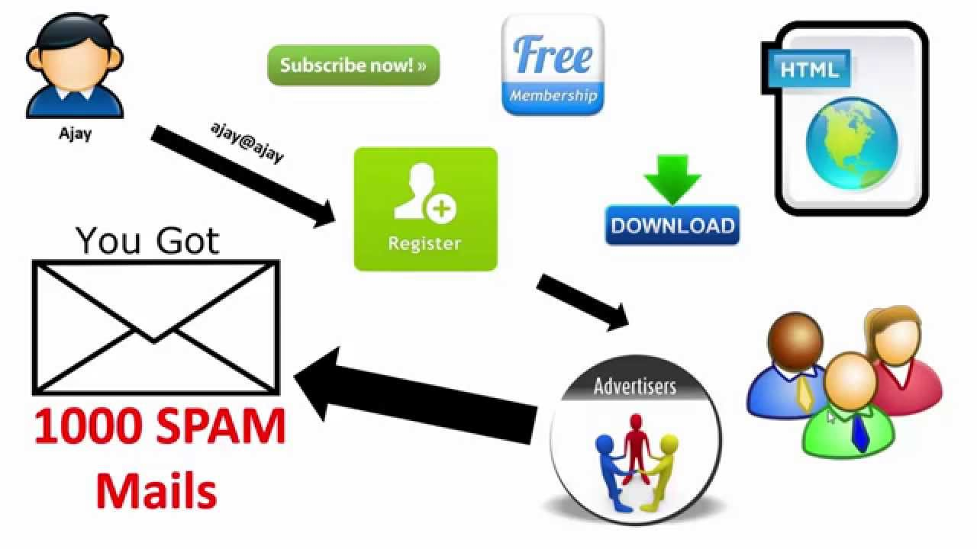
Phishing attacks
a type of social engineering attack often used to steal user data, including login credentials and credit card numbers

Slide 6

Inserting Viruses
With the help of a virus, a hacker can take all your passwords

Slide 7
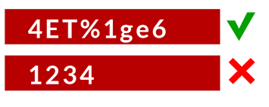
Protect Your Email After Hacked
change old password
1. Notify your friends not to open links that they receive from your email account.
2. Contact the authorities and report that your account has been hacked.

Slide 8

Protect Your Email After Hacked
Install a good antivirus on your computer and update it.
Set up double authentication password if it is supported.

Slide 9



